Slide 1
The increasing dominance
of teams
Linh Tran

Slide 2
Overview
Previous Work
Motivations
Data and Methods
Results
Conclusions
Future Works

Slide 3
Previous Work - Overview
Research and projects are shifting toward teamwork.
Papers written by teams have higher impact than those done by single authors.
Team research dominate the top of the citation distribution in most fields.

Slide 4
Previous Work - Data and Methods
19.9 million research articles and 2.1 million patents records.
5 fields with almost 300 subfields from 1950 to 2000.
Relative team impact:
RTI = | mean number of citations received by team-authored work
 | mean number of citations received by solo-authored work

Slide 5
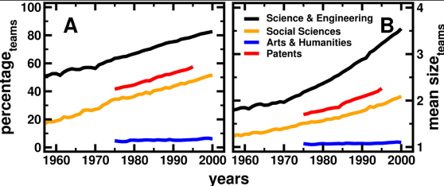
Previous Work - Results

Slide 6
Previous Work - Results
Sciences and engineering:
RTI = 1.7 in 1955.
RTI = 2.1 in 2000.
Similar upward trend in citation is also seen in all other fields.

Slide 7
Motivations
With the growth of science and technology these days, research is typically done with collaboration among people from different fields.
Claim: The ratio between research papers done by teamwork and individuals has increased significantly for teams in recent years.

Slide 8
Data and Methods
Institute of Electrical and Electronics Engineers
110,000 scientific articles during 2010 - 2020
10,000 most cited papers per year
Science and engineering fields

Slide 9
Data and Methods
Collect data using Python and Selenium
Ratio of team-authored and single-authored work
Mean team size
Relative team impact (RTI)

Slide 10
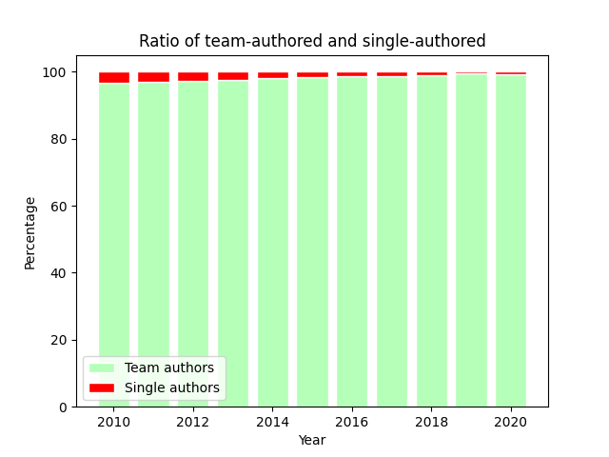
Results
More than 95% are team authors.
Team author trend grows every year.
Increase by more than 10% since
the previous study.

Slide 11
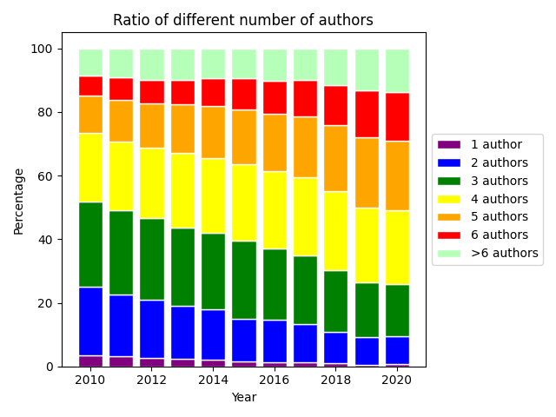
Results
Mostly 3 or 4 authors in the first
first 5 years.
Shifting to 4 or 5 authors in the
next 5 years.
10% papers with >6 authors

Slide 12
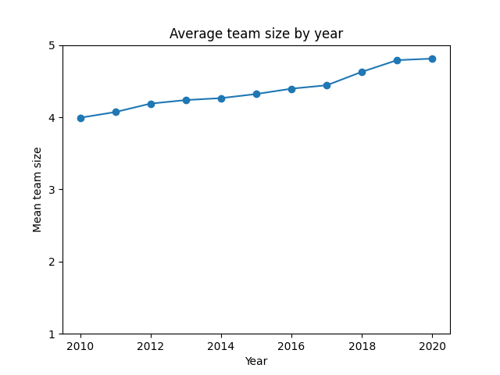
Results
Mean team size also increases
every year.
Grows from 3.5 since 2000 as
illustrated in the previous study.

Slide 13
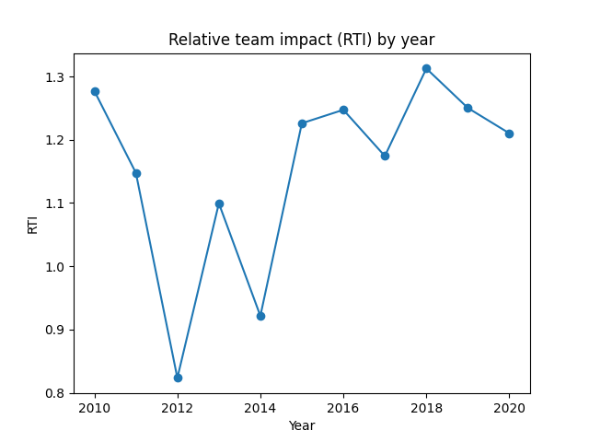
Results
Team authors have higher impact
most of the time.
However, RTI drops significantly
compared with previous study
(1.7 in 1955 and 2.1 in 2000).

Slide 14
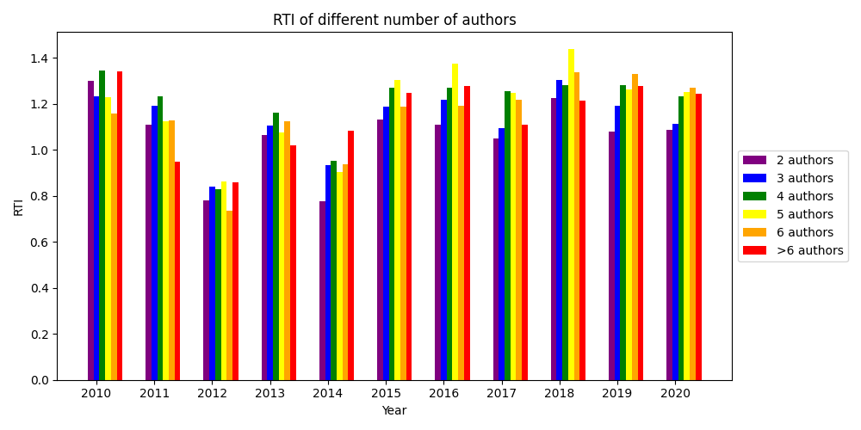
Results
Optimal # authors:
first 5 years: 4
next 5 years: 5

Slide 15
Conclusions
There is a significant growth toward team-authored work with larger mean team size compared with previous study as predicted.
Team research papers do not always receive more citations than solo-authors, but they do show a tendency to produce more highly cited work most of the time.

Slide 16
Future Works
Larger data sets
Different fields with subfields
Analyze the drop of RTI

Slide 17
Thank you for your attention!
Citation
Wuchty, S., Jones, B. F., & Uzzi, B. (2007). The Increasing Dominance of Teams in Production of Knowledge. Science, 316(5827), 1036–1039.

